Slide 1


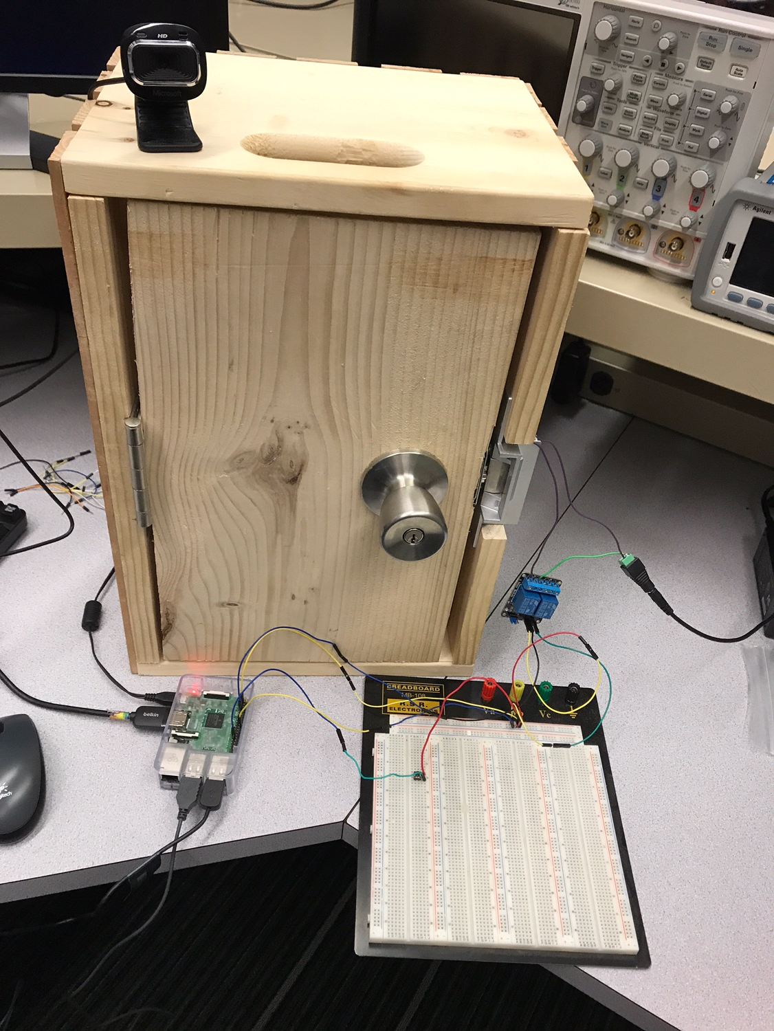
Facial Recognition Smart Door Lock
Jigar Patel, Sam Morin, Huy Tran
Professor Joseph Santacroce
Department Of Computer Engineering and Electrical Engineering, Wentworth Institute of Technology
Abstract
Methods/Materials
Figure 1: PI configuration
Acknowledgements
Conclusions
The goal of this project is to automate the entrance to your house/business without needing a key or ID. For our project, we developed a lock that works based on Facial Recognition.
Oxford API offered by Microsoft is used to control and configure the Facial Recognition part of the project. A further code is added to manipulate API, add/remove users, and analyze faces.
A raspberry Pi is used to handle all the requests from the user. A monitor is used to display input/output received from the user and the system.
We used an electric door strike that requires 5V power to strike. The Power of the door strike is connected to the wall outlet and the input is connected to the IN1 of the 2-Channle Relay.
A push button is used to function as a doorbell. You can press this button to analyze your face. Your face will be compared with the faces saved in the database. It will then grant or deny you access to the door.
The system will stay unlocked for 10 seconds once the door is unlocked with the match of the face. An error message will be displayed if the system is unable to match the face.
Using the Facial Recognition API, Faces will be compared with the one saved in the system
By pressing the pushbutton, it will analyze your face and grant/deny entry based on your facial features.
The door will stay unlocked for 10 second after the entry is granted and the system will then go back to its normal state.
The Internet of Things has become a very popular topic in the technology industry. The IOT refers to connecting any device to the Internet which includes everyday household items like lightbulbs, refrigerators, thermostats, etc. It is estimated that by 2020 there will be over 26 billion IOT devices. This is one of the main reasons why we chose to do our Smart Door Lock. The Smart Door Lock will work by capturing a person’s face and either allowing or denying entry to that person based on facial recognition matches. The door will unlock when the face matches with the one saved in the system.
Introduction
Figure 2: Hardware configuration
We would like to thank Professor Santacroce for guiding us through this project and helping us improve our designs when needed. We would also like to thank Professor Dow for helping us with the PI configuration for power analysis.
http://stackoverflow.com
https://developers.google.com/feed
http://w3schools.com/
Bibliography

